Slide 1

Scenarios where Automation Prevents errors
Presented By:
Lakshika Parihar
500060110

Slide 2

Scenario-1
Querying Users command History

Slide 3
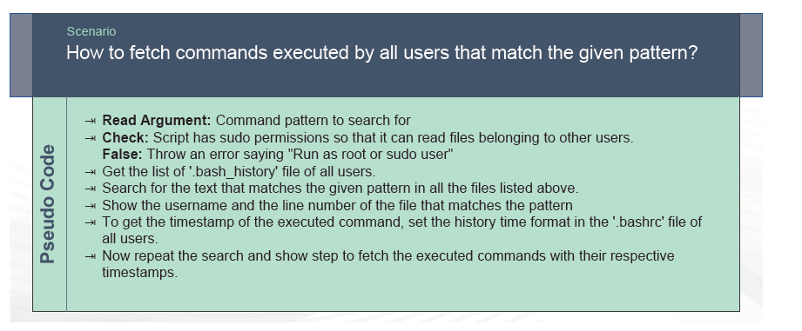

Slide 4
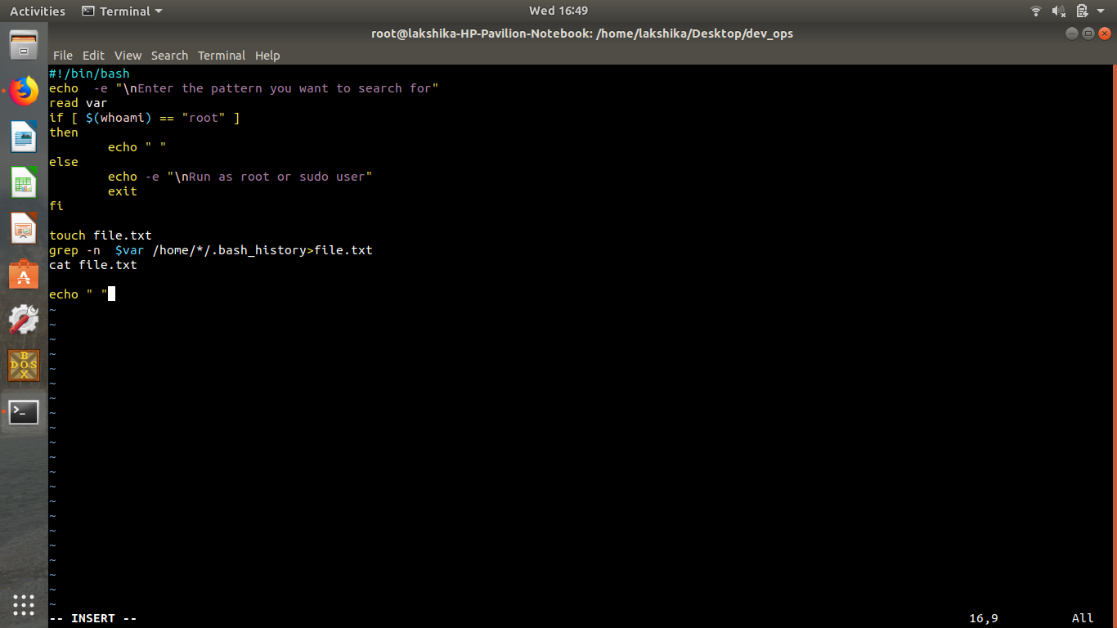

Slide 5
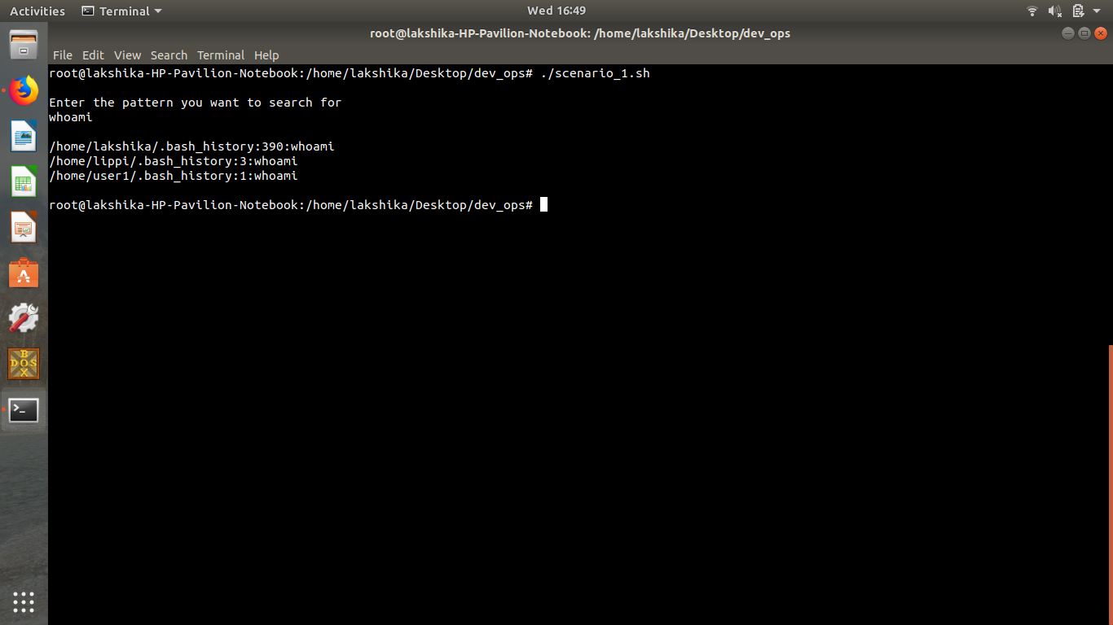

Slide 6
Scenario-2
Bulk Search And Replace

Slide 7
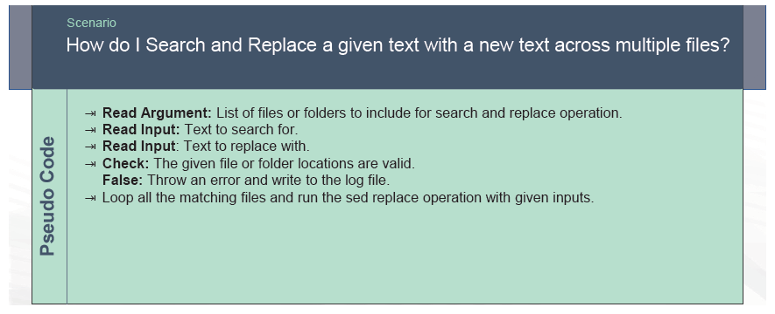

Slide 8
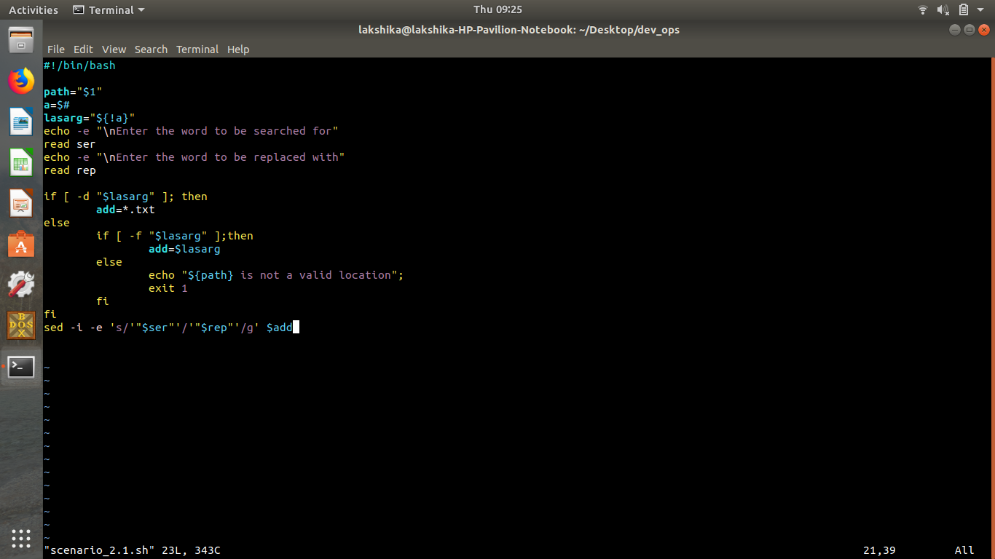

Slide 9
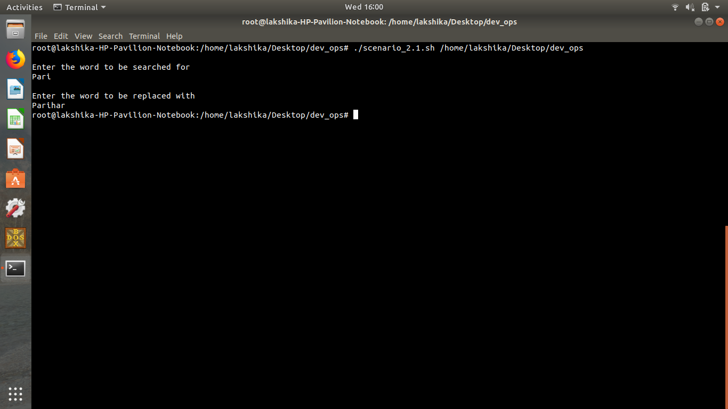

Slide 10
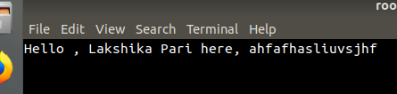

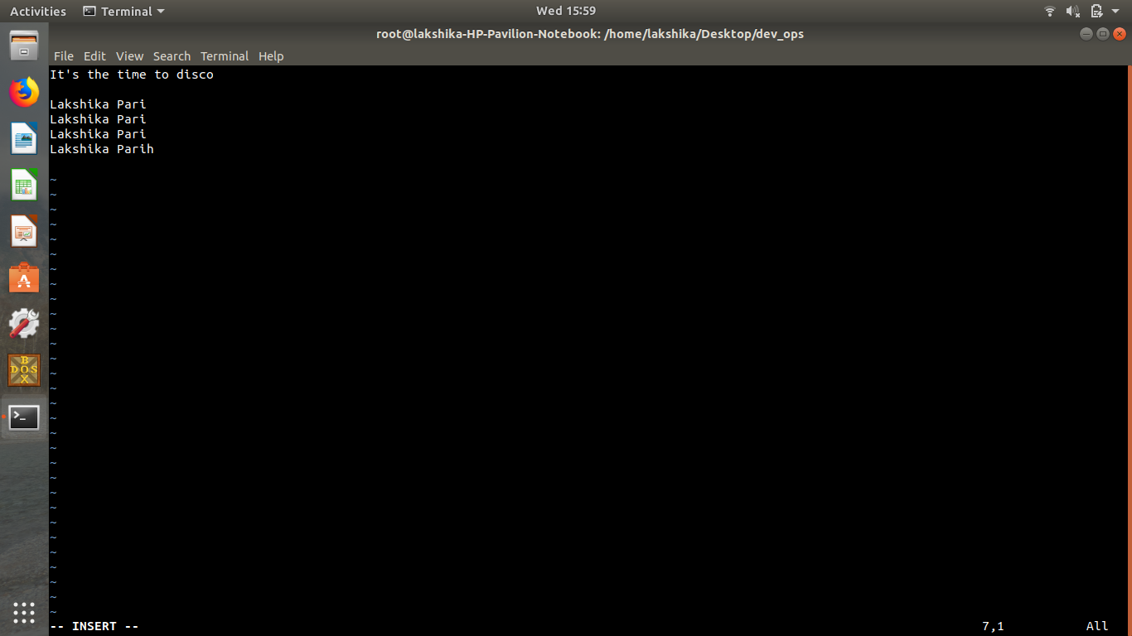

*-

Slide 11
Scenariao-3
Alphanumeric Validator

Slide 12
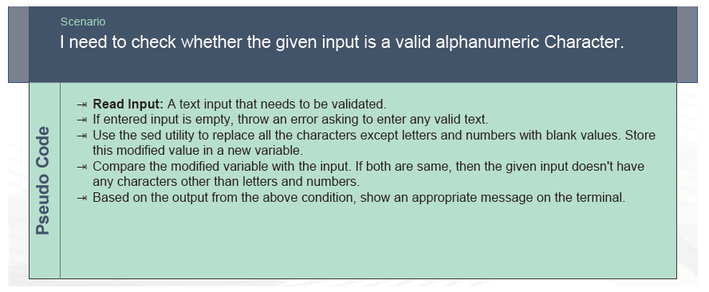

Slide 13
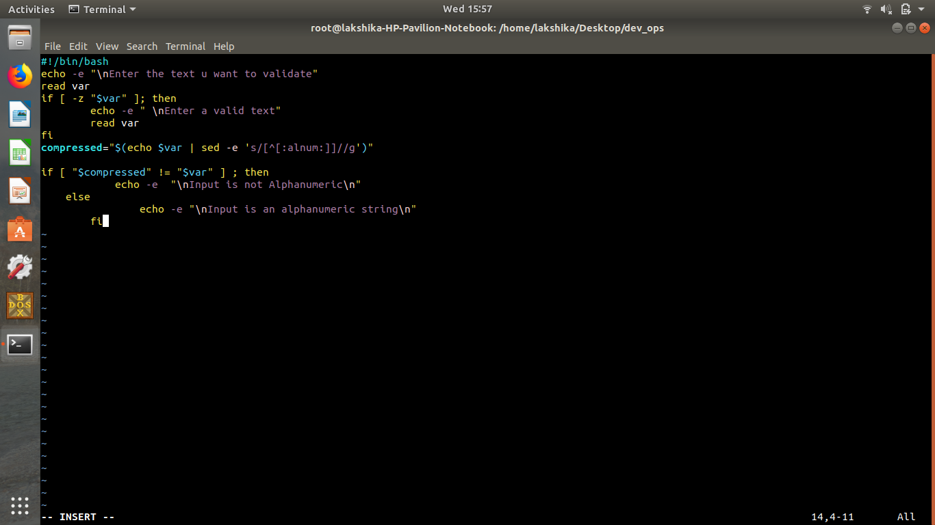

Slide 14
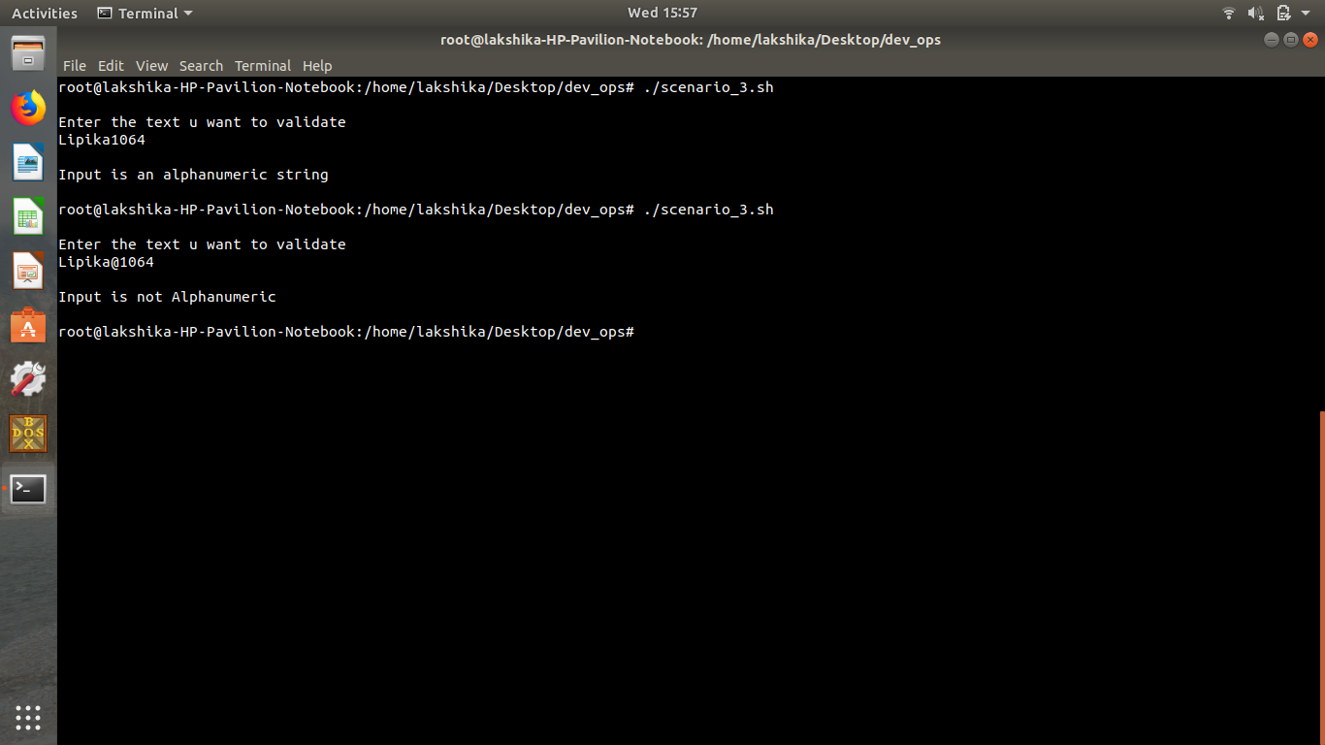

Slide 15
Thank You

